Slide 1
DigiLocker
Presentation by
Satya Verma
HOD, CSE
MATS University
Raipur (C.G.)

Slide 2
What is DigiLocker?
It is web and mobile based system to provide access to issued documents and electronic storage to all users.

Slide 3
About DigiLocker
Digital Locker service operated by Government of India.
Provides 1 GB storage space.
Stores all kind of identity proofs, educational certificates, official documents on cloud.

Slide 4
About DigiLocker
Launched by the Prime Minister on 1st Jul 2015.
Initially provided 10 MB of storage space which now increased to 1 GB.
For paperless administration all municipal bodies were urged to use DigiLocker.

Slide 5
E-Documents on DigiLocker
Uploaded Documents – Uploaded scanned copies of the important documents (Driving License, PAN card, Voter ID, Mark-sheets, Passbook etc.)
Issued Documents – E-documents issued on the DigiLocker by registered issuers. It is stored in central repository from where user can see and share their respective URI (Uniform Resource Indicator) links.

Slide 6
Users of the DigiLocker
Citizen – Citizens can store or access their documents.
Issuers – Issuers can issue e-documents to citizens. They can be various government agencies. (CBSE, Income Tax Department).
Requester – Requester is a government department that offers citizen services or an organization that requires documentation. The requester can request for digital version of the documents and accept those online through the DigiLocker.

Slide 7
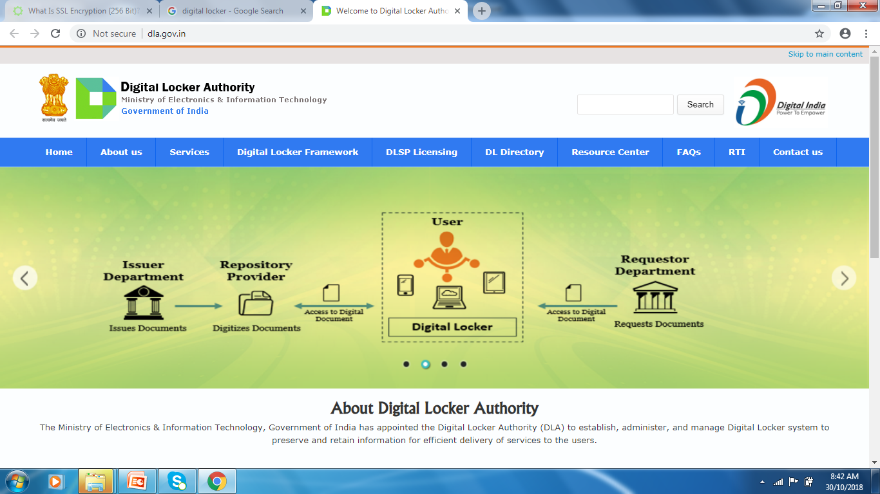
How it Works?

Slide 8
Structure of DigiLocker
My Certificates
  Digital Documents – URI of the documents issued to user by government/other agencies.
  Uploaded Documents – Documents uploaded by user.
My Profile – Complete profile of user as available in UIDAI database.

Slide 9
Structure of DigiLocker
My Issuers – Name of the Issuer and the number of documents issued to the user by the issuer.
My Requester – Name of the requester and the number of documents requested from the user by the requesters.
Directories – Complete list of registered issuers and requesters along with their URLs.

Slide 10
Security Measures
256 bit SSL Encryption
Mobile Authentication based Sign Up
ISO27001 Certified Data Centre
Data Redundancy
Timed Log Out
Security Audit

Slide 11
Benefits of using DigiLocker
Easy Access
Authenticity
Paperless
E-sign

Slide 12
How to access Digilocker?
DigiLocker can be accessed in desktop/laptop using following url.
  https://digilocker.gov.in
For mobile application of DigiLocker, one can download it from playstore/itune.

Slide 13
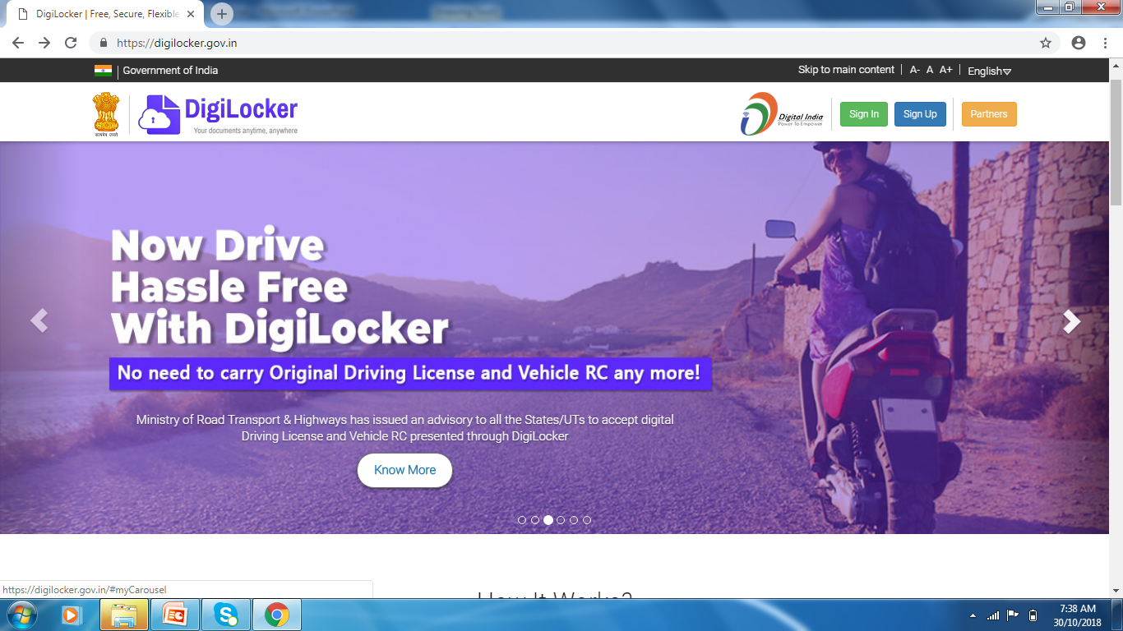
https://digilocker.gov.in

Slide 14
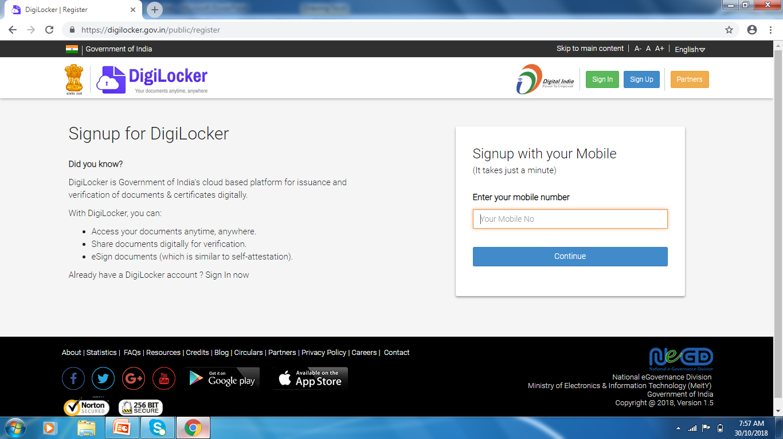
How to Sign In/ Sign Up?

Slide 15
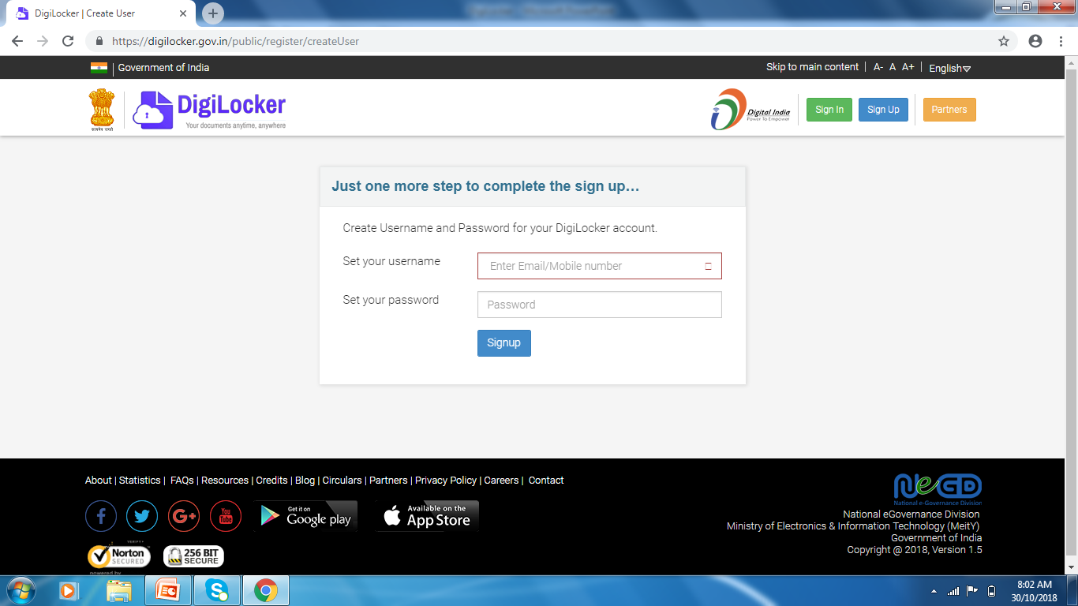
Username and Password Creation

Slide 16
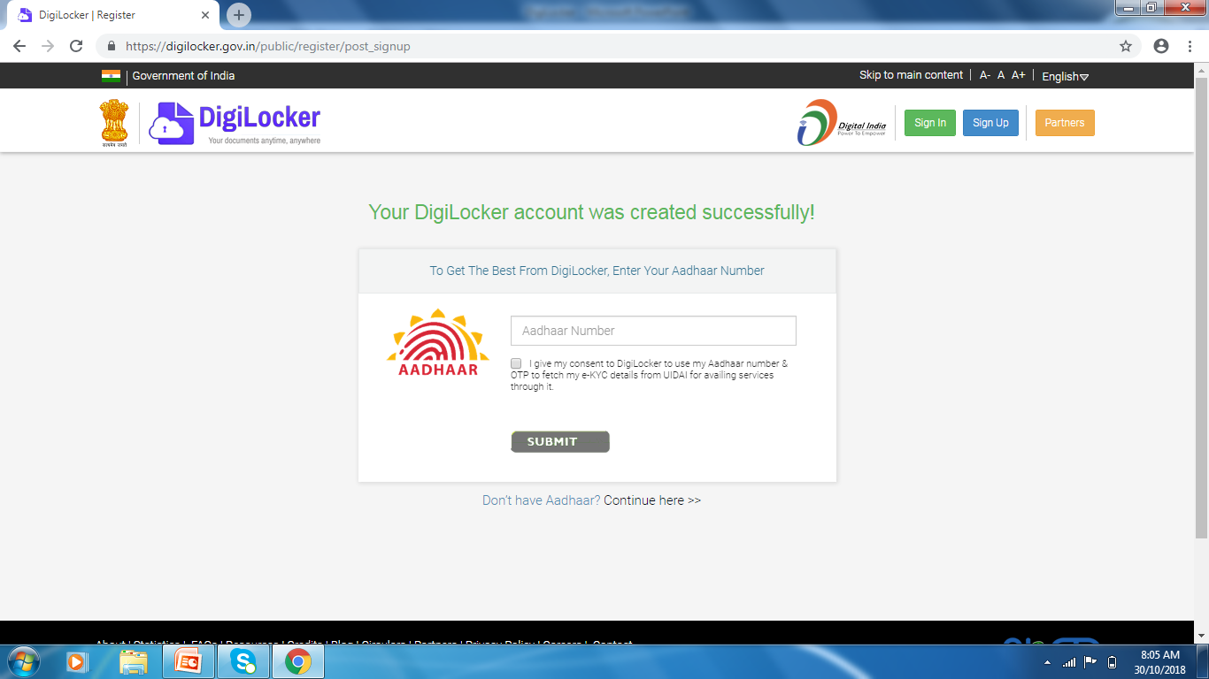
Aadhaar Authentication

Slide 17
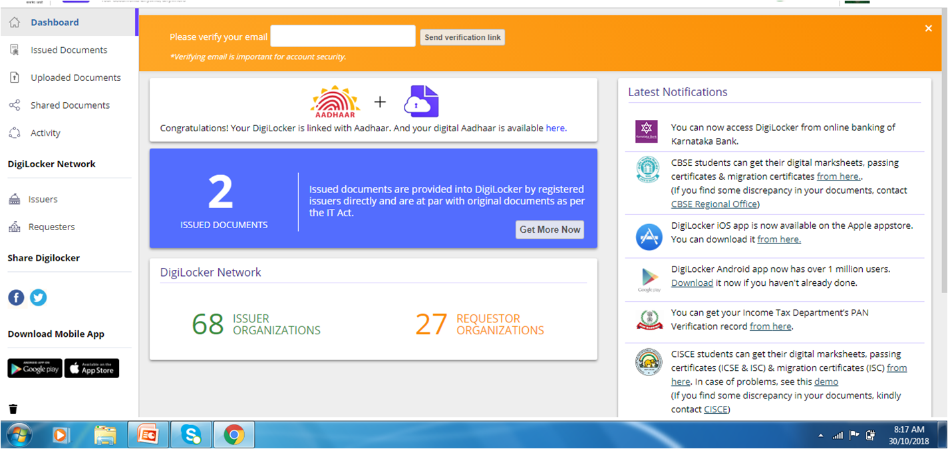
Dashboard

Slide 18
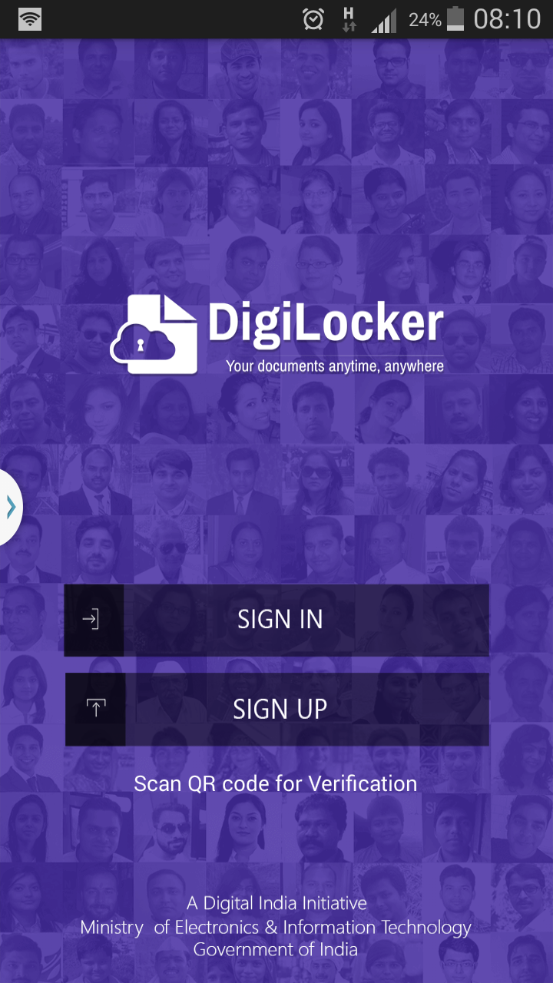
DigiLocker App for Mobile

Slide 19
References
https://digilocker.gov.in
http://dla.gov.in
https://en.wikipedia.org/wiki/DigiLocker

Slide 20


